Slide 1
M-estimation basics for Bias Mitigation
Shameek Bhattacharjee
Western Michigan University
This material is part of NSF OAC 2017289
Scribe: Jordon Matthew Heyboer

Slide 2
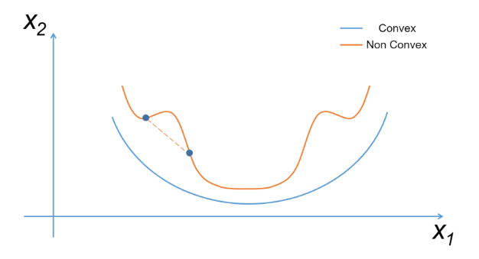
Gradient Descent – Purpose, Rules, and How it works
Purpose
So far, the optimal models have been those that have minimized the cost function. Finding that combination of parameter values can be cumbersome, especially when there are multiple parameters.
Gradient Descent is a method to more efficiently locate this minima.
How it works
Starting point is established.
Calculate slope of tangent line.
Based on magnitude and sign, choose step-size to find next point
Repeat steps 2 & 3 until tangent slope equals 0.
Optimal parameter value is found. Computers automate this process to find this value.
Note: For visual simplicity, this example is for a single parameter estimation, but the intuition is identical for more complex problems.
Note both the magnitude(size) and the sign of the slope.
Negative slope = Before minimum Positive slope = after minimum
Large magnitude = Far from minimum Small magnitude = Close to minimum
Rules
Cost function needs to take a convex shape and be both continuous and differentiable.
An easy way to think of a convex function is having the ability to draw a line between any two points on the function, and if the line is always above the function, then the function is convex.
Large negative slope means taking a large step in positive direction
Cost
Starting point is chosen at random
Step Size
New parameter estimate
Parameter Value

Slide 3
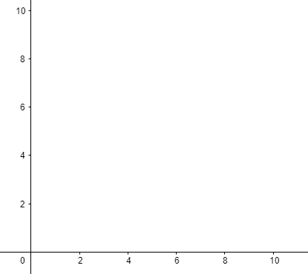
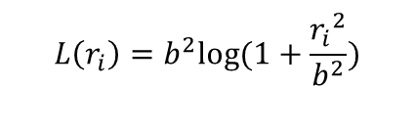

M-Estimation
Given this data, squared residuals will lead to this fitted model, which does a good job.
In the real world, there is data that may or may not purposely try to influence a model in a negative way.
Regularization showed how to account for slighter changes in data but will fail to account for larger and more impactful variations.
M-Estimation is a way to alter the loss function to not easily be biased by penetrators in the training data.
Huber Loss and Cauchy Loss are two M-estimation approaches.
Huber Loss Function:
But when anomalous data enters the scene, the squared residual of this data is so great that it will influence the model in its direction.
Cauchy Loss Function
b acts a hyperparameter that differentiates reasonable residuals from ones that are too large.
b is again a hyperparameter that needs to be explicitly defined.
$$L\left(r_{i}\right)=\left\{\begin{aligned}\frac{1}{2}{r_{i}}^{2}, \left|r_{i}\right|<b \\ &b\left|r_{i}\right|−\frac{1}{2}b^{2}, Otherwise\end{aligned}\right.$$
This loss function really has two different functions depending on the size of the residual.
$${L\left(r_{i}\right)=b}^{2}log⁡(1+\frac{{r_{i}}^{2}}{b^{2}})$$
Once b is established, then the reasonable residuals will utilize the upper loss function, and the rest of the residuals will utilize the lower loss function, which decreases these large residuals influence on the overall empirical risk.
Cauchy works differently as it takes the logarithm of the residual. This causes the loss function to adapt much slower to increasing residuals, which decreases their influence.

Slide 4
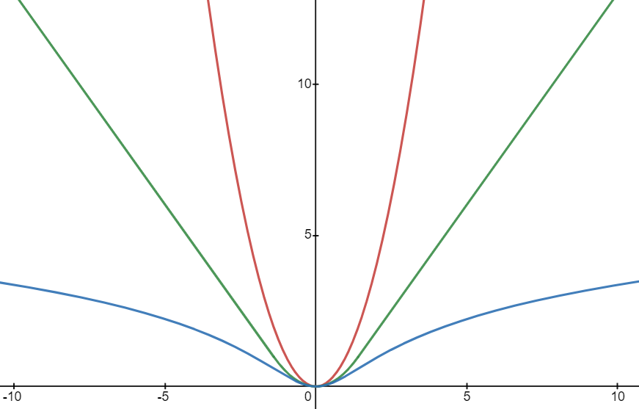
Huber Loss/Cauchy Loss Pattern and Key takeaway
As residuals get larger in both positive and negative directions, their influence is vastly different using M-estimation methods versus Squared Residuals.
Key Takeaways
The value specified for hyperparameter b plays the important role of deciding where the loss functions will really diverge from each other.
Residuals before threshold b have similar Loss Function Outputs but will take vastly different values after.
All three functions are convex, so gradient descent can be used. The problem that occurs when loss functions get flatter is that it's a longer process to perform as the magnitude is not as exaggerated earlier on.
This is a glimpse into another important tradeoff in machine learning, often by increasing the stability and reliability of our models, we sacrifice performance.
A value of 1.4 is chosen for the hyperparameter b in this example. After residual value 1.4, there is a more apparent divergence of the three loss functions in different directions.
Squared Residuals
It is obvious how much less of an influence that larger residuals have on Cauchy and Huber Loss, when compared to Squared Residuals.
Huber Loss
Loss Function Output L(s)
Cauchy Loss
b = 1.4
Residual(s)

Slide 5
General Definition of M-estimation and analysis
Optimal Estimate
Any Loss Function
From M-estimator
family
Parameter space
Influence Function
Gives rate of change
in an estimator given a
Small change in the input’s
Which in turn effect residuals (x-axis)
Direction of increasing
perturbation

Slide 6
Conclusion
The idea of M-estimation is to replace the regular loss function with some other function
That some other function for example equals to what we saw in two examples of Huber Loss and Cauchy-Lorentz loss which you just replace instead of the Square Loss Function
Now how does this work in practice??
We have an entire case study on how this works in prevent problems inside the training data for a cyber-infrastructure like the smart electrical grid.
Check out the case study slides to see these concepts in action

